Slide 1
Welcome to your
Virtual Group Consultation
- Waiting Room -
Your session will begin promptly at
2PM
Notes:
This is just a holding and welcome slide – you may wish not to use this and just welcome patients as they join

Slide 2
General Housekeeping
Camera:
on/off
TO HELP AVOID BACKGROUND NOISE:
Microphone:
mute/unmute
Chat box function
If you would like to speak,
please unmute yourself.
Be in a quiet &
private space
Leave the session
Notes:
Housekeeping slide – this slide should take no more than a couple of minutes key things are to ensure patients know how to mute / unmute themselves (you can mute everyone if things get too noisy). Also encourage patients to keep camera on . Check patients I.T. & connectivity is working but don’t spend too much time on this

Slide 3



Pre-session check-in
Confirm
your
Identity
&
to proceed
type in ‘Consent’
in chat box
Confirm
Confidentiality
agreement
received & read
®
© Group Consultations Ltd
Notes:
Confirm patient identity by asking them to share in chat box – FIRST NAME + INITIAL OF SURNAME + DAY & MONTH ONLY OF DOB . If patients can’t use chat box just get them to unmute and confirm with you they are happy to consent to confidentiality.

Slide 4
Welcome to our Diabetes
Virtual Group Consultation
Your Facilitator is Anu Ramakrishnan
Your Clinician is Jahnavi Veeramasuneni
Notes:
ADD IN SPECIFICS WHERE HIGHLIGHTED – explain in simple terms your role as facilitator e.g. To help everyone get the best from our session and keep us all to time …. Good idea to highlight here that clinician will be joining the session soon

Slide 5
Flow of our session today
Set session up and introductions
Quick look at our results board
Your questions for the clinician
Clinician session and one-to-ones
Agree next steps /close session
®
Notes:
This helps patients know what is happening in the session and when – should only take you a couple of minutes to run through

Slide 6

Your name &
how long you’ve lived with Diabetes
Introductions
®
Notes:
Remember to keep introductions quick and snappy as we only have around 5 mins for this section – this is covered in more detail in our facilitators training

Slide 7

What are YOUR questions
for the clinician?
®
© Group Consultations Ltd
Notes:
You may not want to use this slide and just go round the group asking the patients the key questions / issues they want to raise with clinician – either have results board printed out and write question next to patients name or use post it notes – you may need to come back to specific questions during the session – Covered in more detail in facilitators training

Slide 8
What is Diabetes?
Diabetes means too much sugar in the blood.
The body makes insulin, but the cells don’t respond properly — called insulin resistance.
Sugar stays in the bloodstream and damages blood vessels and organs.

Slide 9
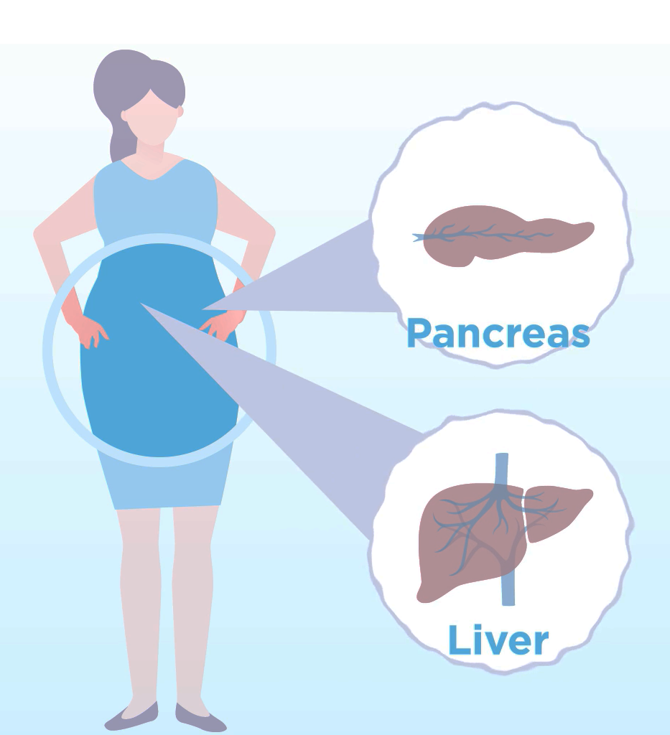
What causes Type 2 Diabetes?
Excess body fat
Excess fat in the pancreas reduces insulin production
Some stored under skin
Notes:
Let’s start off by looking at what causes type 2 diabetes.
*The issue for most people type 2 is excess body fat. The amount of fat you can store before it starts becoming a problem varies from person to person.
*You can store a certain amount of fat under your skin, but when you have too much fat, it has to go somewhere else in the body
*The places the fat goes include the liver and the pancreas, resulting in fatty liver and fatty pancreas.
*Once it gets into the pancreas it stops the pancreas from producing insulin effectively, which causes Type 2 diabetes…it’s actually a tiny amount of fat that causes the problem – it only needs about half a gram of fat to reduce insulin production

Slide 10

How much sugar is in your blood?
The average adult has about one teaspoon (4 grams) of glucose in their bloodstream.
In diabetes, sugar builds up far beyond that — slowly damaging the tiny blood vessels in the eyes, kidneys, heart, and nerves.
Our goal today: learn how to keep that one teaspoon balanced.

Slide 11
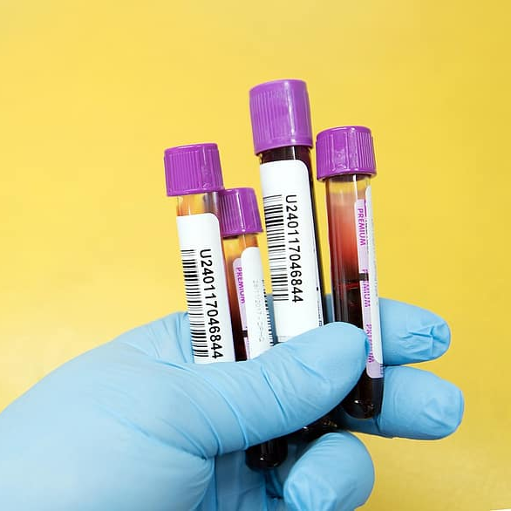
How is blood sugar measured?
We use two different measurements:
Blood glucose. An on the spot check
HbA1c. Average blood glucose over the last 3 months
Notes:
It really helps to understand blood sugar levels
*We use two different measurements:
*Blood glucose. A spot check that you can do several times a day. It’ll change depending on what you’ve just eaten and when that was. Normal fasting values are 4-6
*HbA1c. We use this for longer term monitoring. It measures how much glucose has been in your blood for the past 3 months. Because it’s a longer term measure, it doesn’t go up and down as you eat.

Slide 12
What do my HbA1c levels mean?
HbA1c – measures the average blood glucose (sugar) over 3 months
Remission
Normal
HbA1c under 42
Prediabetes or Non-Diabetic Hyperglycaemia
HbA1c 42 to 47
Diabetes
HbA1c 48 or above
Low risk
High risk
Notes:
What do my HbA1c levels mean?
*Remember that HbA1c measures the average blood glucose over 3 months
*Under 42 is normal
*42-47 is prediabetes or as we call it non-diabetic hyperglycaemia (which is quite a mouthful!!)
*48 and above is diabetes.
*The higher the HbA1c goes the higher your risk of developing heart disease, kidney disease and other complications as well as more severe infections
*If you’ve got Type 2 diabetes and you get your HbA1c below 48 for 6 months without medication, it means you’re in remission. But the Type 2 diabetes can come back, particularly if you put the weight back on

Slide 13
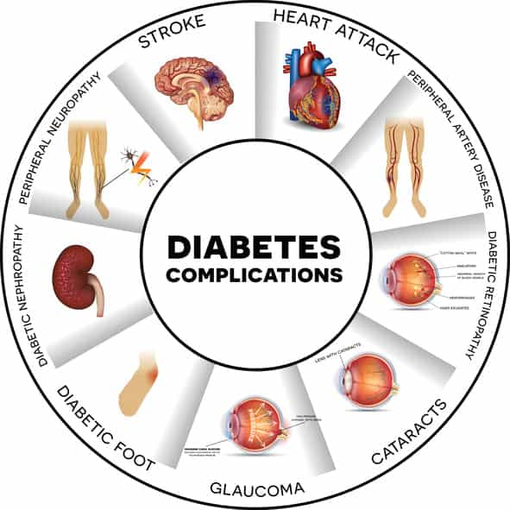
Understanding the Numbers
Every 1% (11 mmol/mol) rise in HbA1c increases:
• Heart attack risk by ~18%
• Stroke risk by ~15%
• Eye & kidney disease by ~35%

Slide 14
Why Control Matters
High sugars damage blood vessels and nerves:
• Heart disease: 2–4× higher risk
• Kidneys: leading cause of kidney failure
• Eyes: 1 in 3 develop retinopathy
• Nerves: 1 in 4 develop numbness
Good control protects eyes, heart, kidneys, and feet.

Slide 15
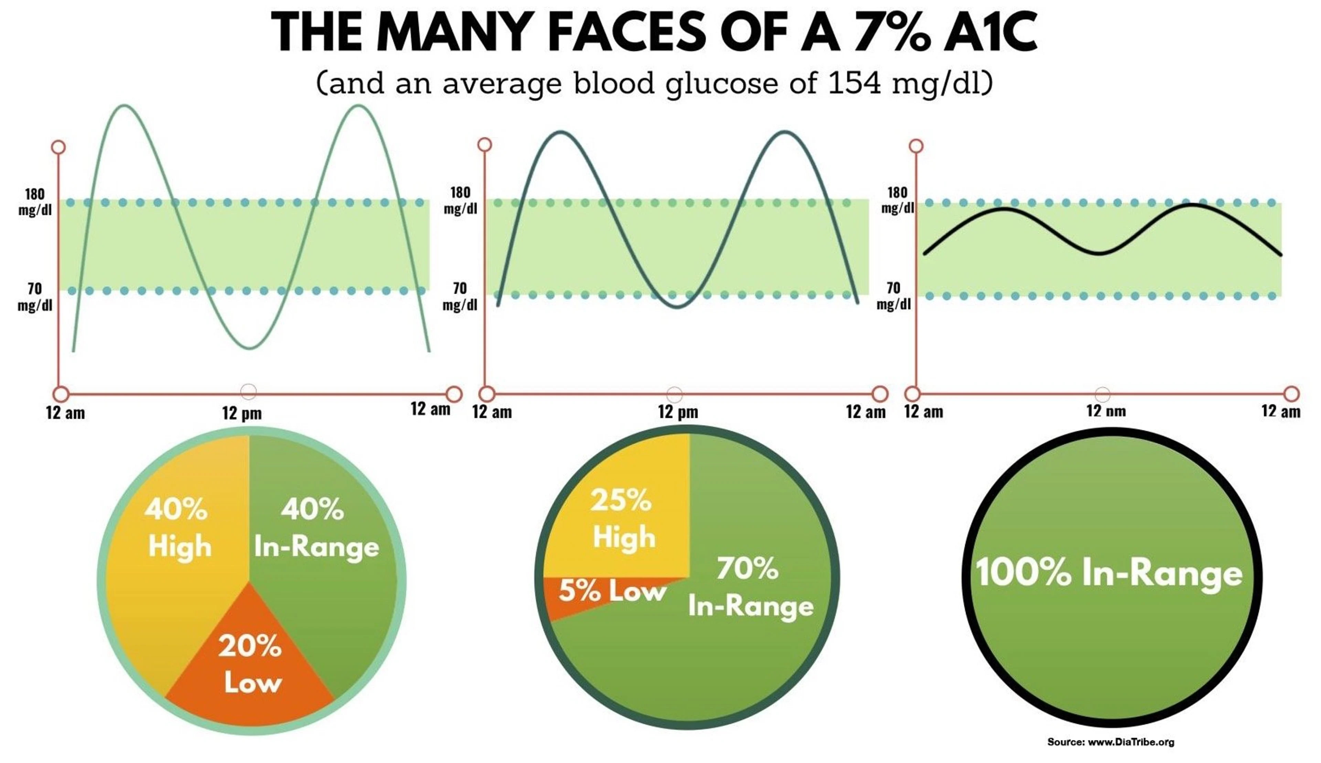
Time in Range
Time in Range (TIR) = % of time blood glucose is between 4–10 mmol/L.
Goal: ≥70% in range ≈ HbA1c 53 mmol/mol.
Each 10% drop in TIR raises retinopathy risk by ~60%.

Slide 16
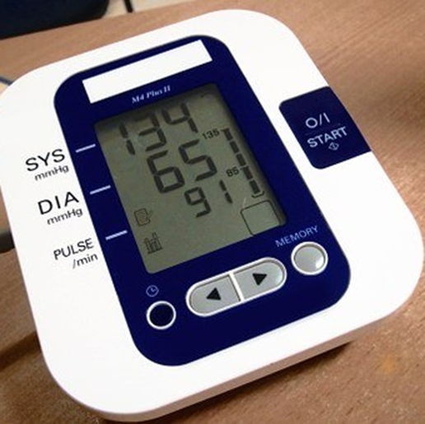
Blood Pressure & Heart Health
Ideal BP: below 135/80 mmHg.
Every 10 mmHg rise above increases:
• Stroke risk by 20%
• Heart disease by 15%
Controlling BP + sugar halves heart attack risk.

Slide 17
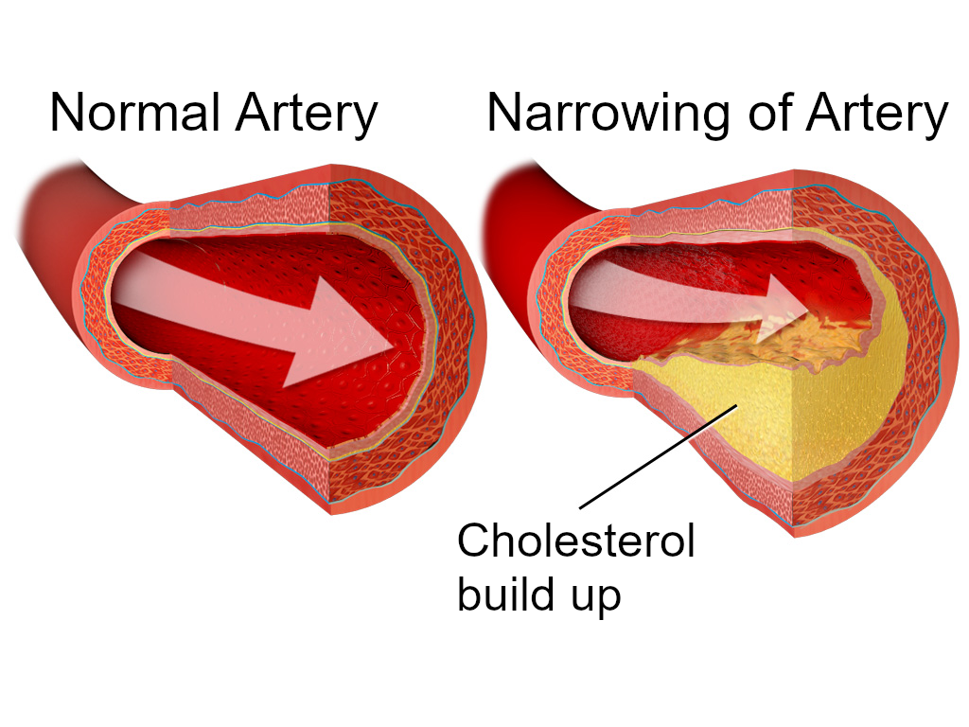
Is cholesterol harmful?
Cholesterol is essential for life and can be good (HDL cholesterol) and bad (non-HDL cholesterol)
Bad cholesterol causes build up in the artery walls
If a build up breaks apart, it can cause a heart attack or a stroke
To understand your risk of heart disease it’s best to look at your non-HDL cholesterol
Ideally non-HDL cholesterol should be below 3.35
Notes:
That’s quite a lot of confusion about cholesterol
*Cholesterol is essential for life and can be good (HDL cholesterol) and bad (non-HDL cholesterol)
*Bad cholesterol causes build up in the artery walls
*If a build up breaks apart, it can cause a heart attack or a stroke
*To understand your risk of heart disease it’s best to look at your non-HDL cholesterol
*Ideally non-HDL cholesterol should be below 3.35

Slide 18
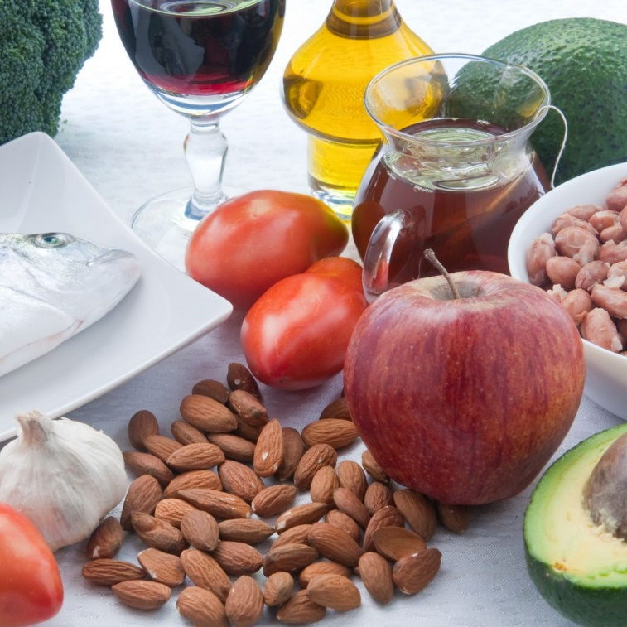
How can I keep my bad cholesterol levels down?
Eat more:
Good fats including olive oil, oily fish and avocados, nuts and seeds
Beans and green vegetables
Reduce:
Carbohydrates (sugar, starch – e.g. rice, bread, pasta, noodles - and fruit juice)
Trans and saturated fats (biscuits, cakes, crackers, fried fast foods)
Get more active
Quit smoking
Notes:
To keep bad cholesterol levels down and good cholesterol levels up, there are some simple steps you can take
*Eat more:
*Good fats including olive oil, oily fish and avocados, nuts and seeds
*Beans
*Green vegetables
*Reduce:
*Carbohydrates (sugar, starch – e.g. rice, bread, pasta, noodles - and fruit juice)
*Trans fats (biscuits, cakes, crackers, fried fast foods)
*Exercise
*Quit smoking

Slide 19
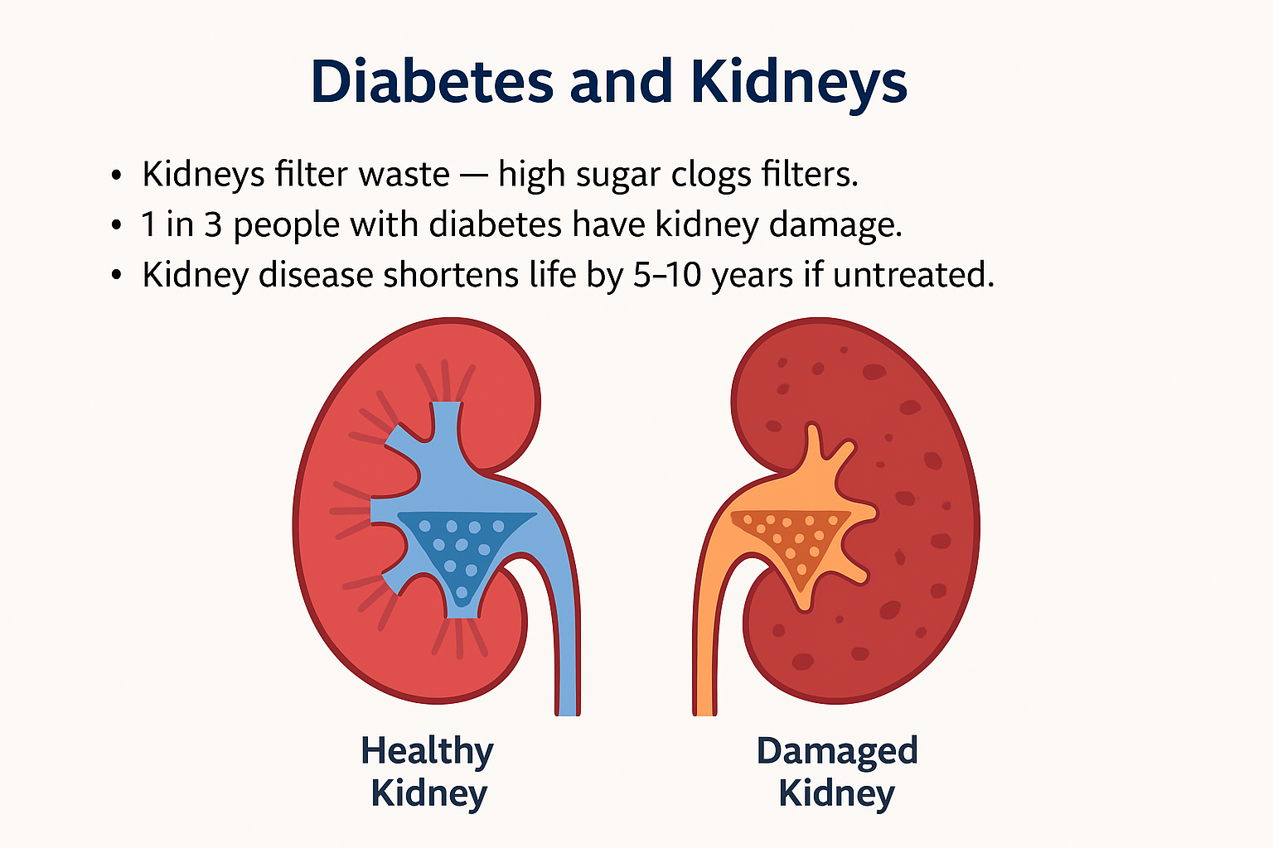

Slide 20
Eyes & Feet Screening
👁️ Eyes: 30% develop retinopathy; yearly screening prevents 90% of vision loss.
🦶 Feet: Nerve damage causes ulcers/infection. Check daily, wear good shoes, attend foot checks.

Slide 21

What does an ideal healthy plate look like?
Whole Grains or Starchy Veg
(less=best)
Water is best thirst quencher
Use plenty of healthy, minimally processed oils and fats including olive oil and butter
Beans, Nuts, Seeds, Low Carb Fruits
Low Carb Veg
(mix of colours,
growing above the ground)
Protein Foods e.g. peas, meat, eggs, full fat dairy and soy
Notes:
*The ideal plate looks something like this
*Lots of vegetables that grow above the ground, plenty of vegetable proteins and healthy fats. If you’re eating carbs which include rice, bread, potatoes, and pasta, try and choose high fibre ones, like brown rice or lentils and keep portions small – ideally less than quarter of a plate
*Drink plenty of water – it keeps you hydrated, quenches your thirst and helps you feel full

Slide 22
Why focus on carbohydrates (carbs)?
Carbohydrates (carbs) cause blood glucose to rise more than any other food type
Excess blood glucose is converted to fat
Can’t burn fat while you still have short term carb stores (glycogen) in your liver
Blood glucose
Minutes after eating
Notes:
Why is cutting carbs so important?
*Carbohydrates (carbs) are digested into glucose and cause blood glucose to rise more than any other food type
*Excess blood glucose is converted to fat
*You can’t burn fat while you still have short term carb stores (we call this glycogen) in your liver

Slide 23
Which foods contain carbs?
Sugar molecule
Sugars. Found in sweets, cakes, pastries, fruit juices and energy drinks
Starch (long chains of sugar). Found in foods such as bread, rice, pasta, cereals, potatoes, yam, plantain, noodles, dumplings and West African dough like fufu and gari.
  Starch is broken down into sugar in your body
Starch
Notes:
So let’s take a closer look at carbs
*There are two main types:
*Firstly – sugar – that’s things like glucose, sucrose, fructose. You can taste these, they’re sweet. They’re in sweets, cakes, pastries, donuts, and also fruit and fruit juices as well as soft drinks
*Secondly there’s starch, which is found in lots of foods – bread, rice, pasta, cereals, potatoes, yam, plantain, noodles, dumplings and West African dough like fufu and gari
You don’t actually really need carbs for anything

Slide 24
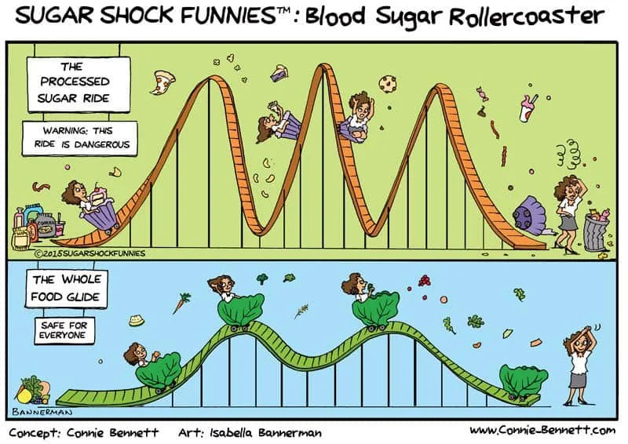
The Blood-Sugar Rollercoaster
High-carb foods → sugar spike → insulin surge → sugar crash → hunger & cravings.
This repeats, causing tiredness and weight gain.
Break the cycle with balanced meals (protein + fibre + healthy fat).

Slide 25
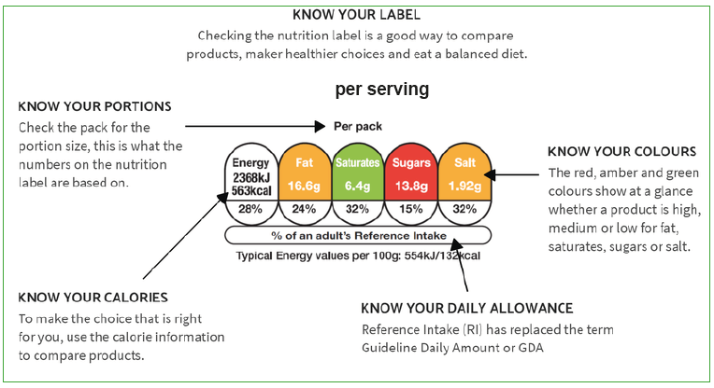
Reading Food Labels

Slide 26
How to Read Food Labels — for People with Diabetes
1️⃣ Start with ‘per 100 g’ — easier to compare products.
🟢 Look for lower total carbohydrates and sugars (< 15 g carbs / < 5 g sugar per 100 g).
2️⃣ Check fibre — aim for ≥ 3 g per 100 g; higher = better for glucose control.
3️⃣ Watch fats — saturated fat < 1.5 g / 100 g; choose olive, rapeseed, nuts, seeds.
4️⃣ Traffic lights — aim for more 🟢 greens and fewer 🔴 reds (sugar, fat, salt).
5️⃣ Portion sizes — double‑check what a ‘serving’ actually means!
6️⃣ Ingredients order — sugar in the first three = likely high sugar product.
💡 Quick rule: Less sugar, more fibre, fewer reds, simpler ingredients.

Slide 27
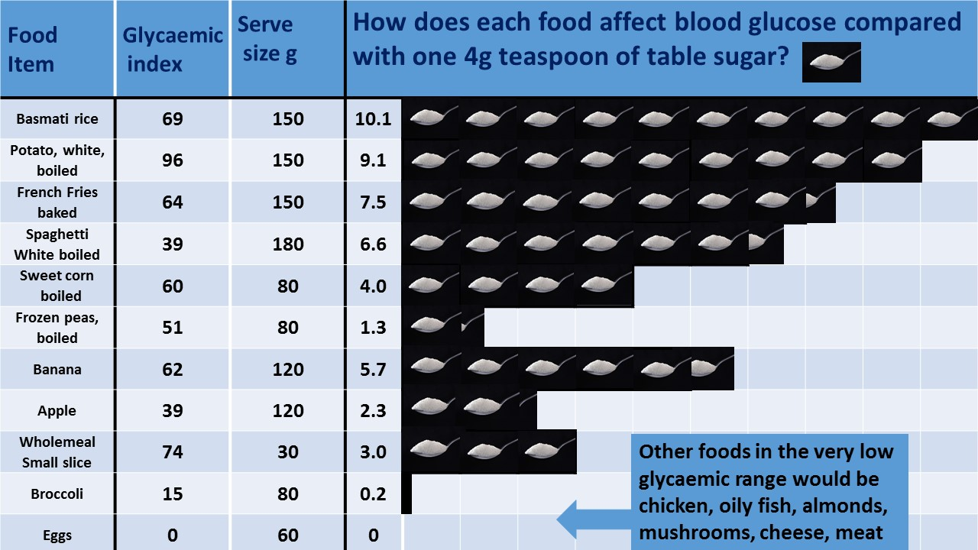

Slide 28
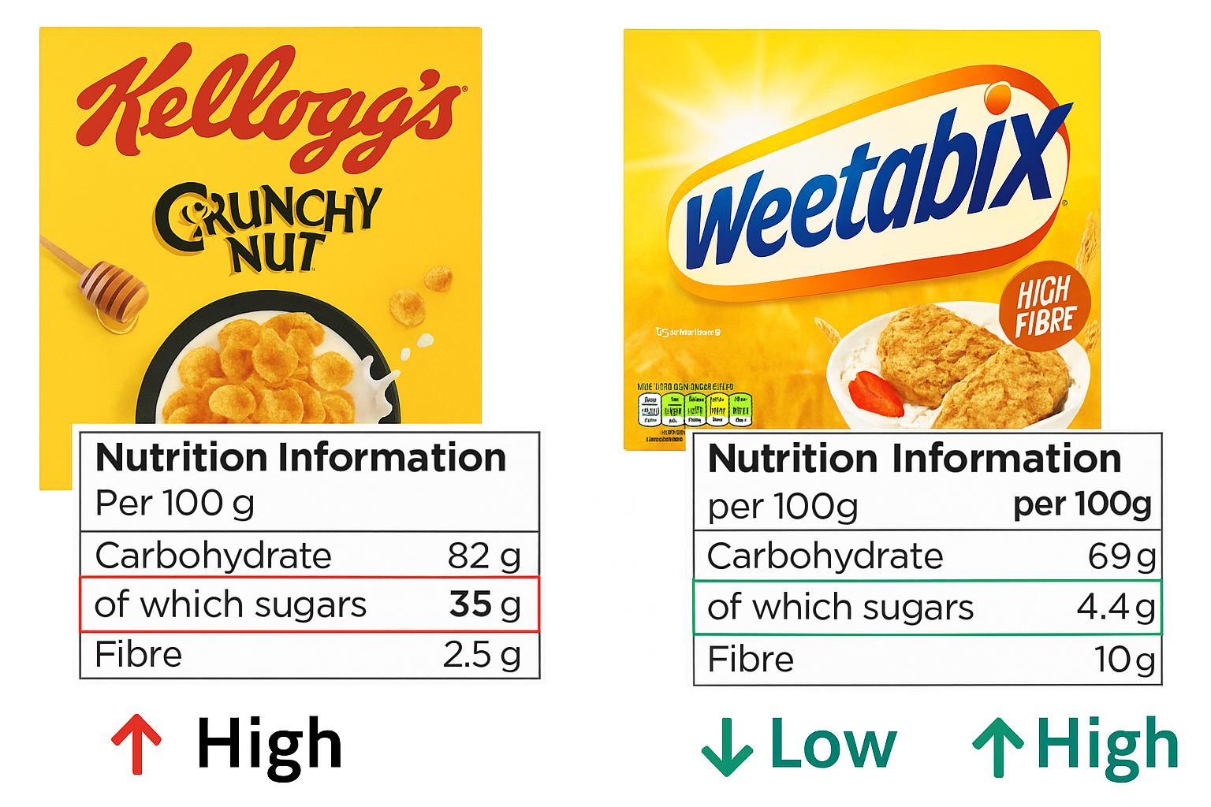
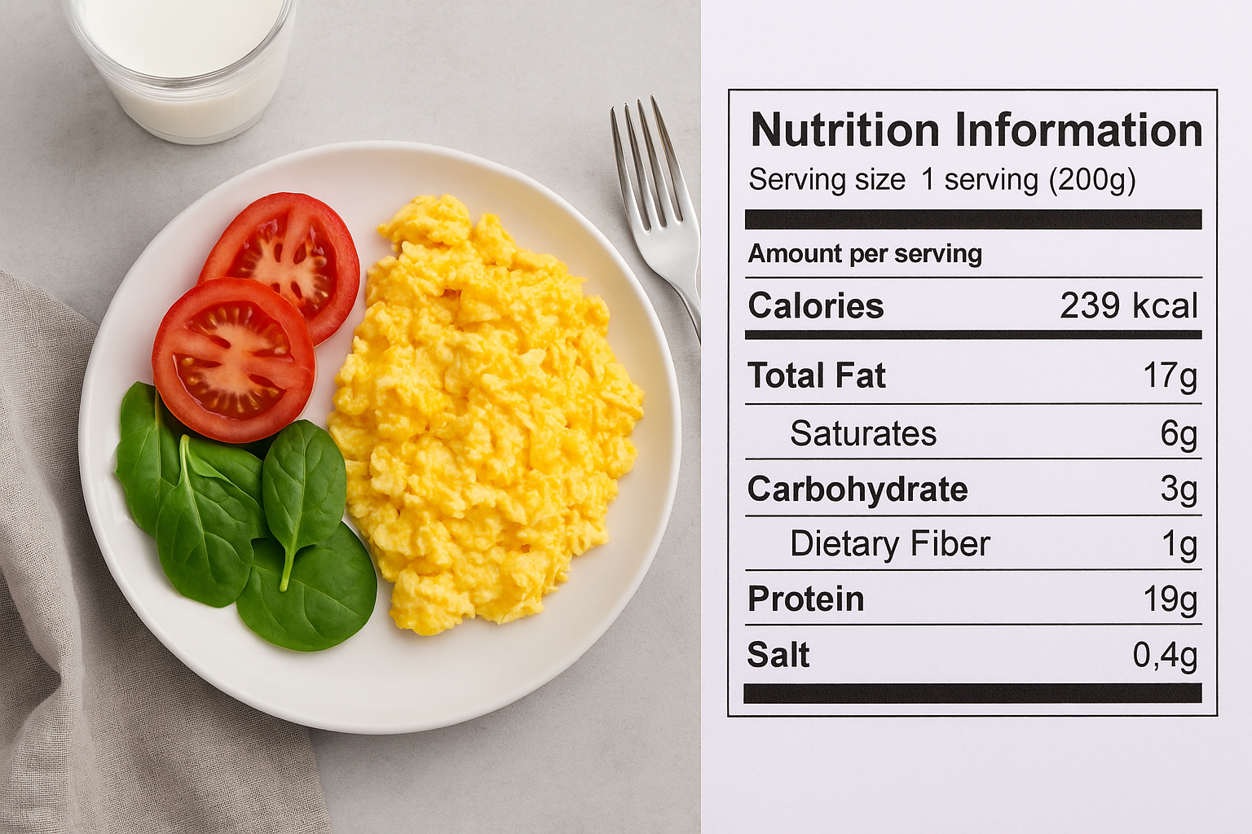
Compare Breakfast options

Slide 29
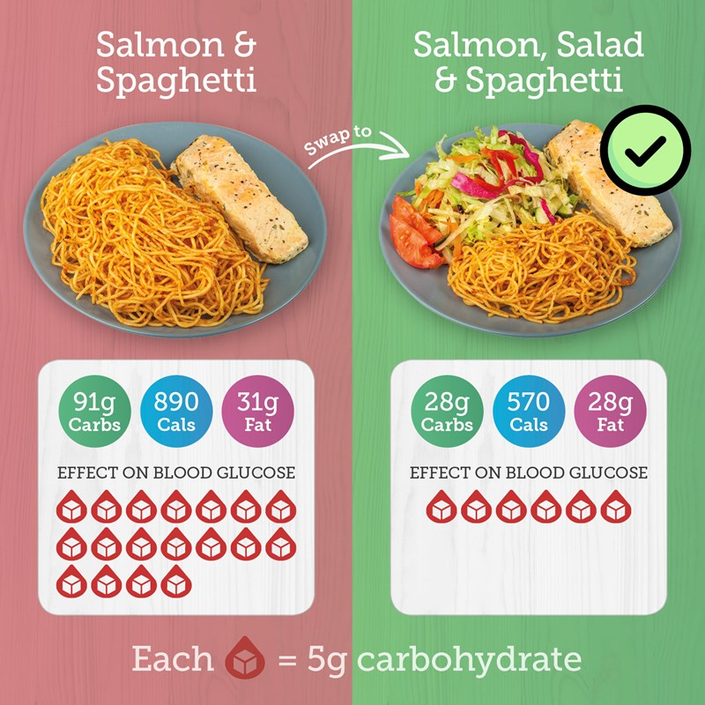
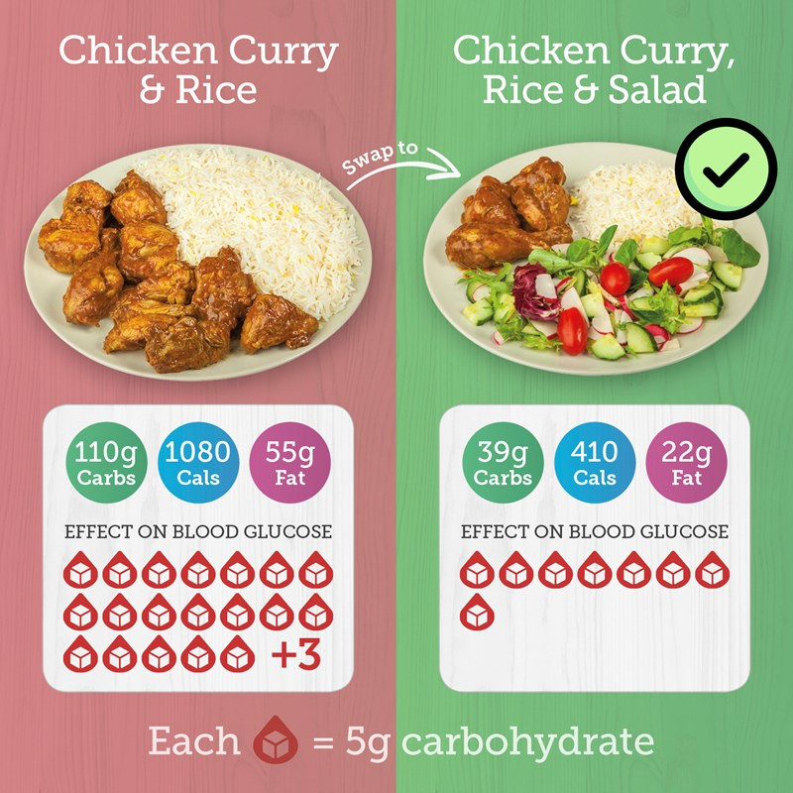
Healthy swaps
18 teaspoons sugar
22 teaspoons sugar
Notes:
Even without removing all carbs from your food, you can make swaps that will result in significant reductions in blood sugar
Here are a couple of examples of healthy swaps which result in reducing the amount of carbs
You can see that the image with the pink background has large amounts of carbs – each red drop is 5g of carb or one teaspoon of sugar:
The spaghetti is equivalent to 18 teaspoons of sugar
The rice is equivalent to 22 teaspoons of sugar
By changing most of the carbs to salad or green vegetables you’ll experience a huge difference in blood sugar levels

Slide 30


Slide 31
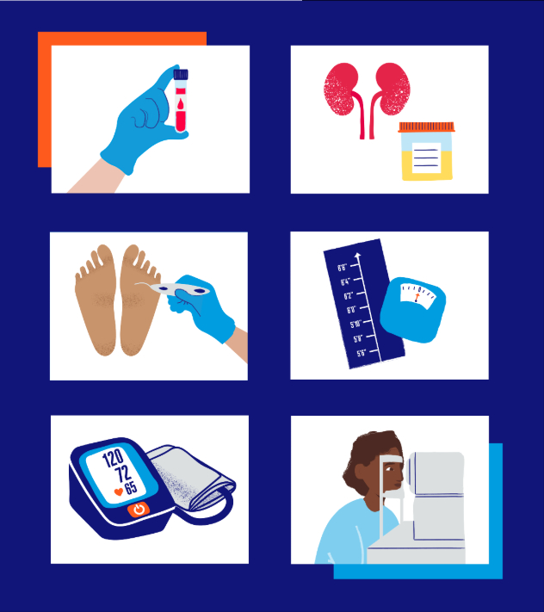
COMPLICATIONS ARE NOT
INEVITABLE
Keeping blood sugar, blood pressure and blood fats under control will hugely help to reduce your risk of developing complications.
Attend your diabetes health checks regularly.
You can prevent or delay the complications of diabetes.
It’s all about managing your diabetes well.

Slide 32

🗣️ Your Thoughts Before We Finish
https://forms.gle/ZAcjo8Vk1MFBAThD7

