Slide 1

Meeting Overview
Updates from May meeting
Review of current access routes
Introducing new tools
Listening to your feedback
Working together to improve access
Q&A
Next Meeting
Patient Participation Group
August 2025

Slide 2
Updates from May
Website updated (our team) to include additional roles
New TV graphics to introduce roles
New PPG updates section

Slide 3
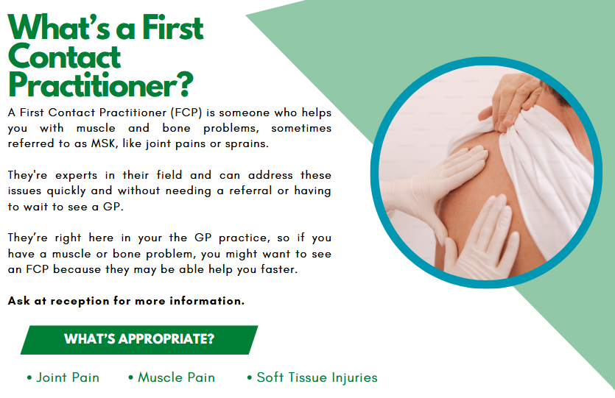

Slide 4



Do not edit
How to change the design
What do you currently use/have you heard of to access healthcare services? Tick all that apply:
The Slido app must be installed on every computer you’re presenting from

Slide 5
Current Ways to Access the Practice
Phone – Speak to reception or request call-backs
In Person – Visit reception during open hours
Online – NHS App, SystmOnline, eConsult

Slide 6
What We’ve Heard from Patients
Difficulty getting through on phones
Unaware of digital options
Desire for fair, flexible access

Slide 7
Getting you the help you need
Our Goals
Improve access and reduce wait times
Ensure patients feel heard and supported
Offer choice in how care is accessed
Make things easier, not harder

Slide 8
Getting you the help you need
Supporting Everyone
Reception team available to help patients use online tools or complete it on their behalf
Printed guides at reception
SystmConnect is optional — all other routes stay open
Focus on fairness and digital inclusion

Slide 9
Getting you the help you need
Introducing SystmConnect
New online contact forms
Available during opening hours as minimum, some 24/7
For admin and non-urgent medical queries
Helps get requests to the right team without the need for a call or visit
Part of improving access without replacing other options

Slide 10
Why SystmConnect?
Integrates with existing routes and clinical system
No account required – but you can log in using NHS App or SystmOnline/Airmid credentials to speed things up
Reduce pressure on phone lines
Easier for patients to explain their needs
Prioritised based on clinical need
Speeds up response for many
No need to queue - Submit non-urgent / routine requests and await a response
Getting you the help you need

Slide 11
Looking Forward
What’s Next?
Campaign to raise awareness of access options
Ongoing staff training
Patient feedback built into every stage
Monitoring how each route is used

Slide 12
Getting Involved
Your Role as the PPG
Share experiences
Spread awareness in the community
Identify concerns or barriers
Help shape communication materials

Slide 13
Brainstorm:
In groups, think about:
  One concern/barrier that patients may experience when it comes to digital services
  One idea for how patients could be helped to feel more confident using online services
  Excluding appointments, 3 reasons you might need to contact the practice
Helping us to help you

Slide 14
Discussion

Slide 15
Wrapping Up
Questions
Updates from the practice
Next meeting: Tues 11th November

Slide 16

BYTES PCN

